Slide 1
Assignment 2-A TurtleBot3 Burger Teardown
GROUP 1
Chinmay Vilas Samak
Tanmay Vilas Samak
GitHub Repository

Slide 2
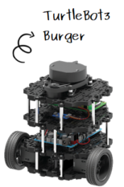
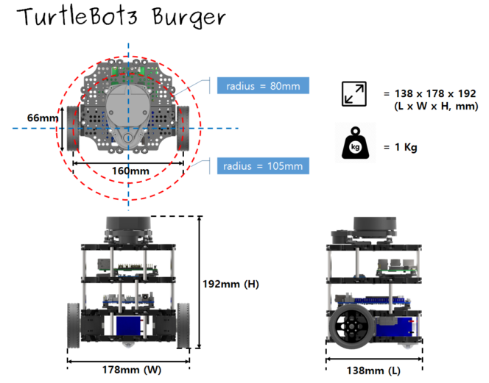
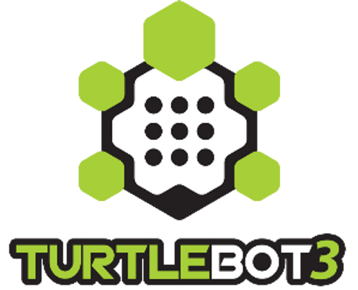
Feature Overview
Differential drive mechanism
Small form factor
Multi-mode actuators
Multi-sensor lineups
Affordable cost
Open hardware
Open firmware
Open software
ROS enabled
Source: ROBOTIS Inc.

Slide 3
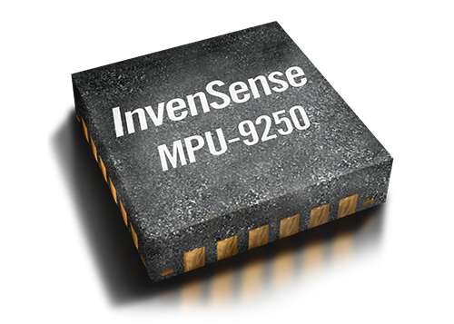
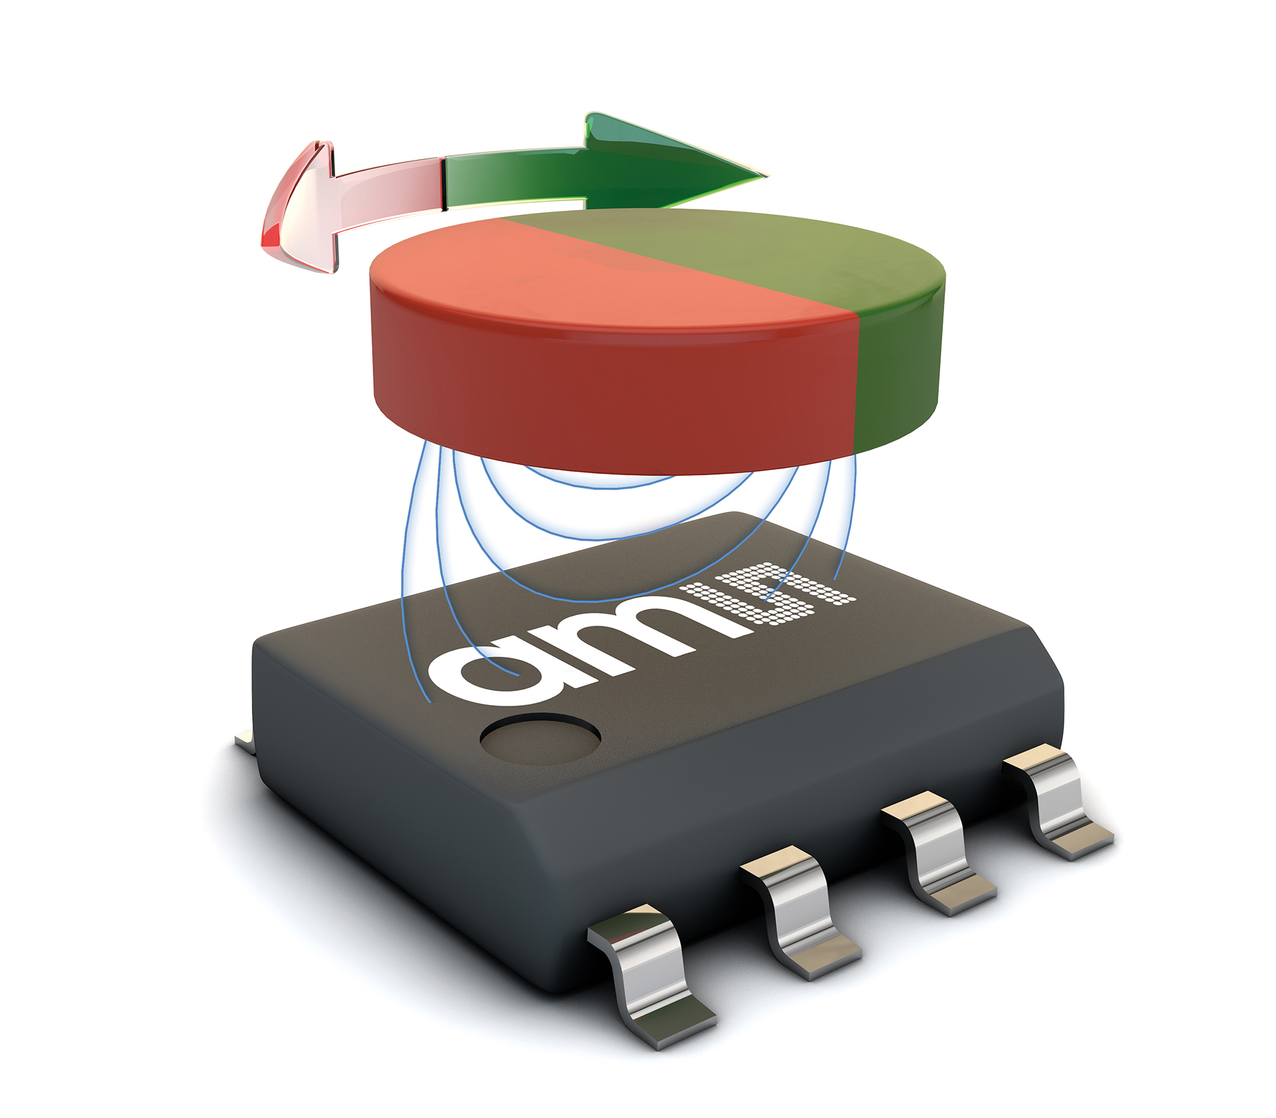
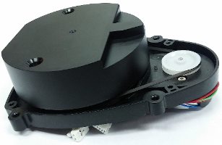
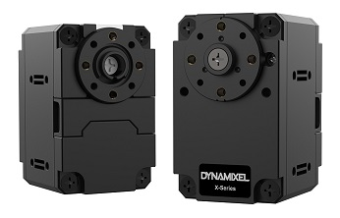
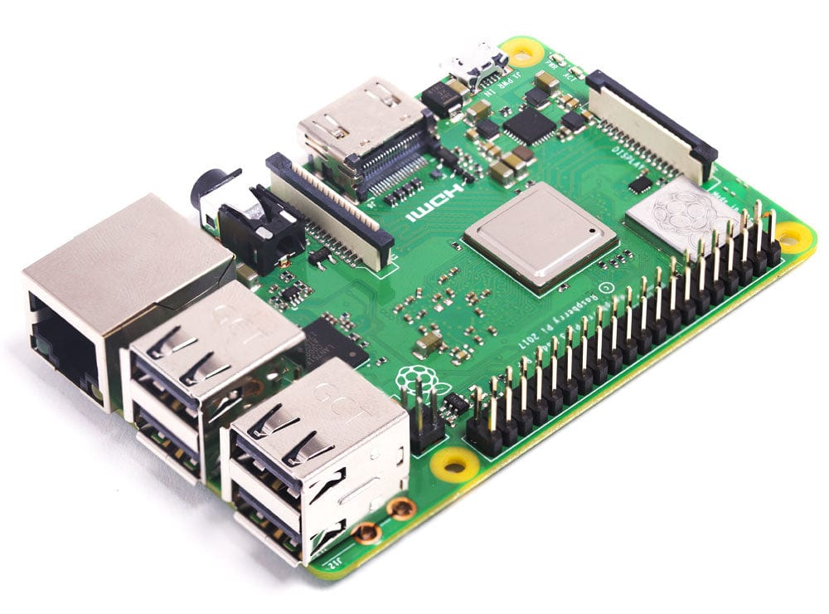
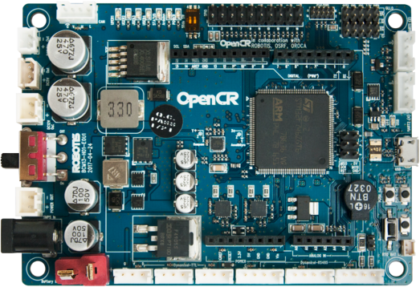
Existing Hardware
Note 1: Complete list of specifications available here
Note 2: The TurtleBot3 Burger provided in class has add-on Pi Camera v2
Battery: 11.1 V 1800 mAh LiPo
Sensors:
LDS-01 360° planar LiDAR*
MPU-9250 9-axis IMU**
AS5601 magnetic absolute encoders
Computers:
Raspberry Pi 3B+ single board computer (SBC)***
OpenCR1.0 auxiliary low-level controller board
Actuators: DYNAMIXEL XL430-W250-T continuous rotation servos (CRS)
*LDS-02 is applied since 2022.
**9-axis MPU-9250 IMU has been replaced with 6-axis ICM-20648 IMU since 2020.
***Raspberry Pi 3 Model B+ is applied since 2019. Earlier model is equipped with Raspberry Pi 3 Model B. Raspberry Pi 4 Model B is applied since 2021 September.

Slide 4
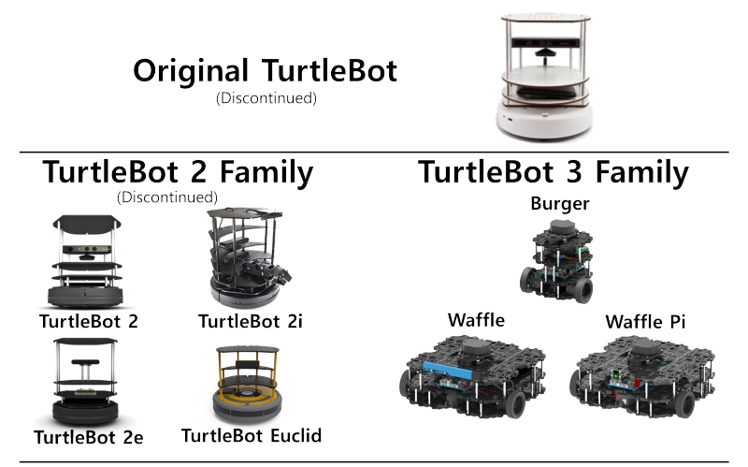
TurtleBot Version Comparison
TurtleBot Version | Mobile Base | Battery Pack | Computer(s) | Sensor(s) | Actuator(s) | Developer(s) | Release Date
TurtleBot1 | iRobot Create | 3000 mAh | Asus 1215N Laptop | Gyro, MS Kinect (RGBD-Cam), Encoders | iRobot Create Robot Base Motors | Willow Garage | Nov 2010
TurtleBot2 | Yujin Kobuki | 2200 mAh | Asus 1215N Laptop | Gyro, MS Kinect (RGBD-Cam), Encoders | iClebo Kobuki Robot Base Motors | Yujin Robot | Oct 2012
TurtleBot3 | Burger, Waffle, Waffle Pi | 1800 mAh | Raspberry Pi (or Intel Joule 570x), OpenCR1.0 | 2D LiDAR, 9-Axis IMU, Encoders, Pi Camera (Mono-Cam), Intel RealSense RGBD-Cam | DYNAMIXEL Servo Motors | ROBOTIS, OSRF | May 2017
TurtleBot1: Costs $1400, large, less flexibility, deprecated
TurtleBot2: Costs $1500, huge, less modular, deprecated
TurtleBot3: Costs $650, small, modular, continued support
Robotis and OSRF Announce TurtleBot 3 Smaller, Cheaper, and Modular (IEEE Spectrum, By Evan Ackerman, 12 Oct 2016)
Source: IEEE Spectrum
Source: TurtleBot.com

Slide 5
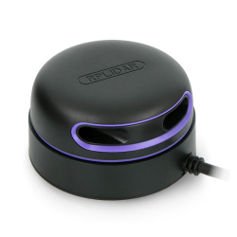
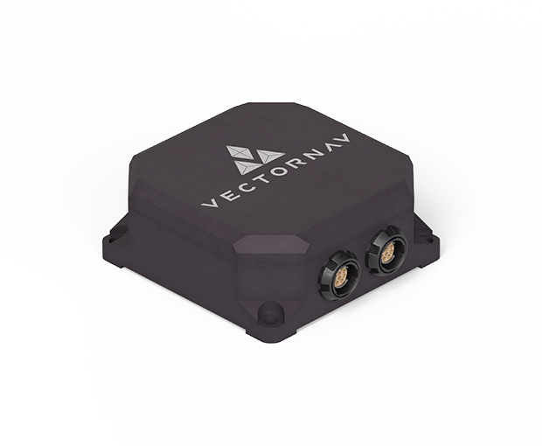
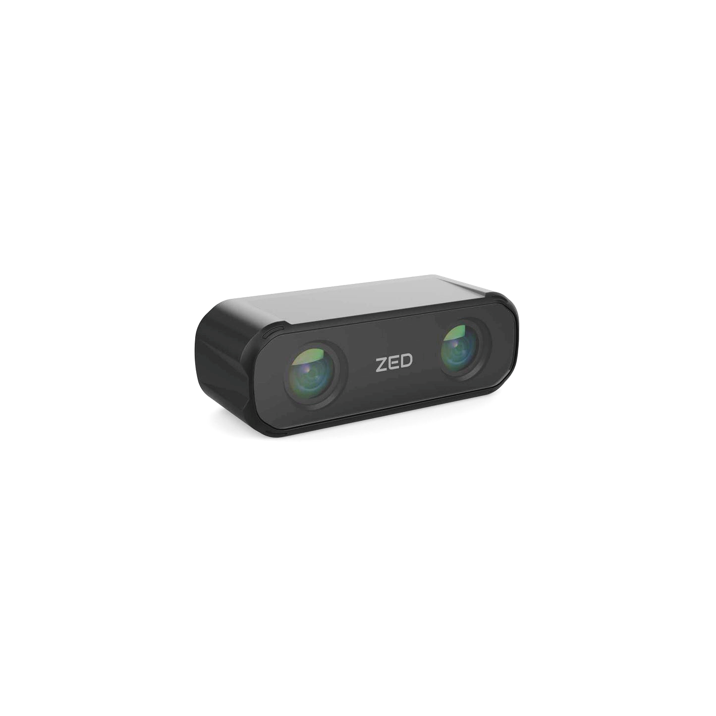
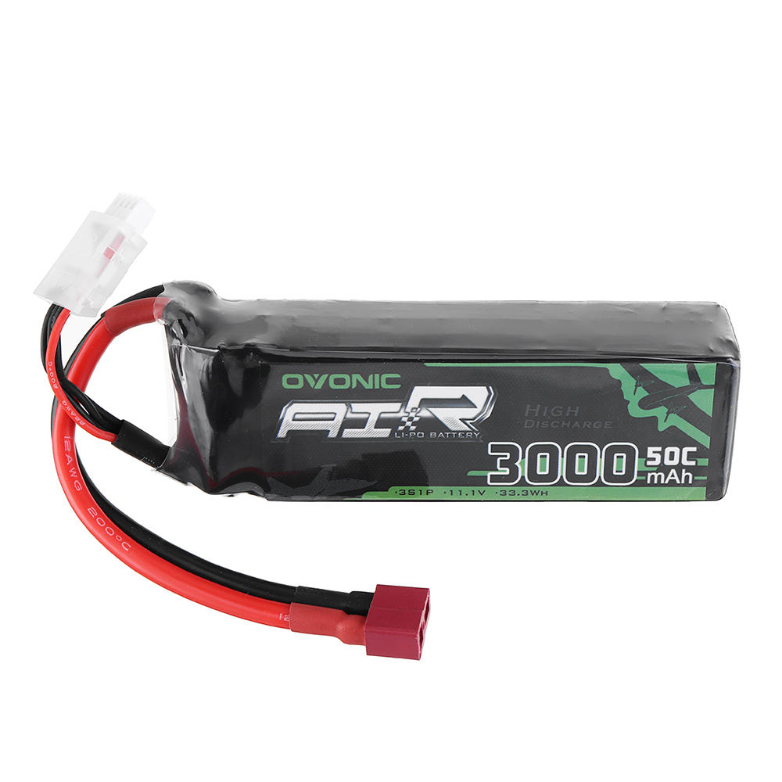
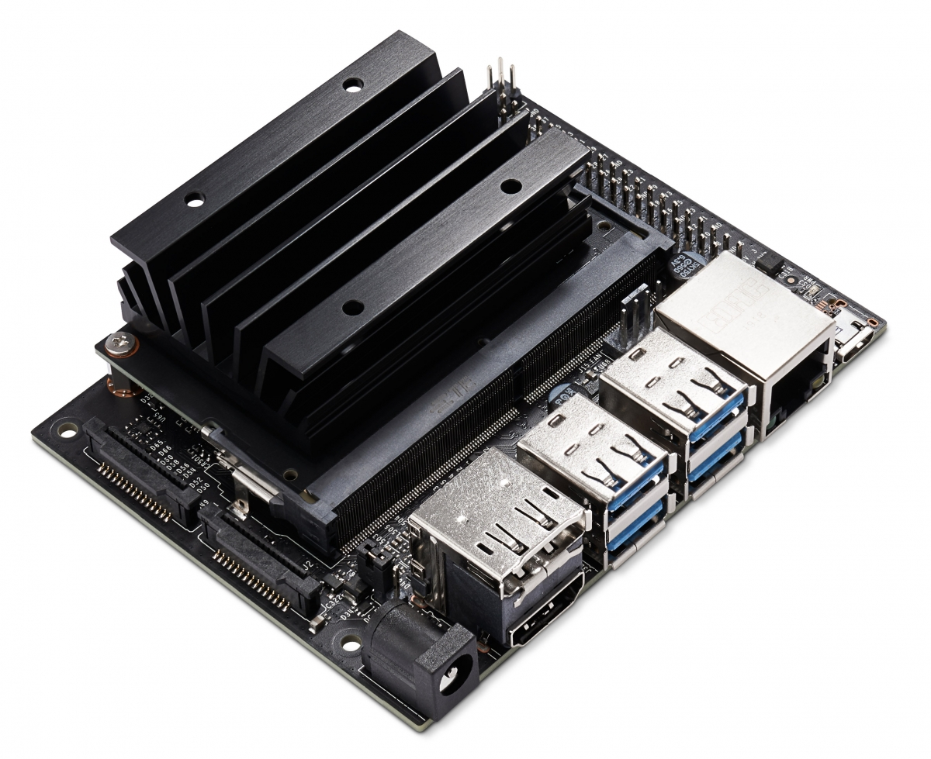
Replacement Hardware
Note 1: Actuators and low-level compute need not be replaced
Note 2: These replacements do not consider cost constraint
Battery: 11.1 V 3000 mAh 3S 50C LiPo
Sensors:
LiDAR: RPLIDAR-A3 360° planar LiDAR
IMU: VN-110 9-axis IMU
Encoders: AS5601 magnetic absolute encoders
Camera: ZED X Mini RGBD camera
Computers:
High level: Jetson Nano B01 developer kit
Low level: OpenCR1.0 auxiliary low-level controller board
Actuators:
DYNAMIXEL XL430-W250-T continuous rotation servos (CRS)

Slide 6

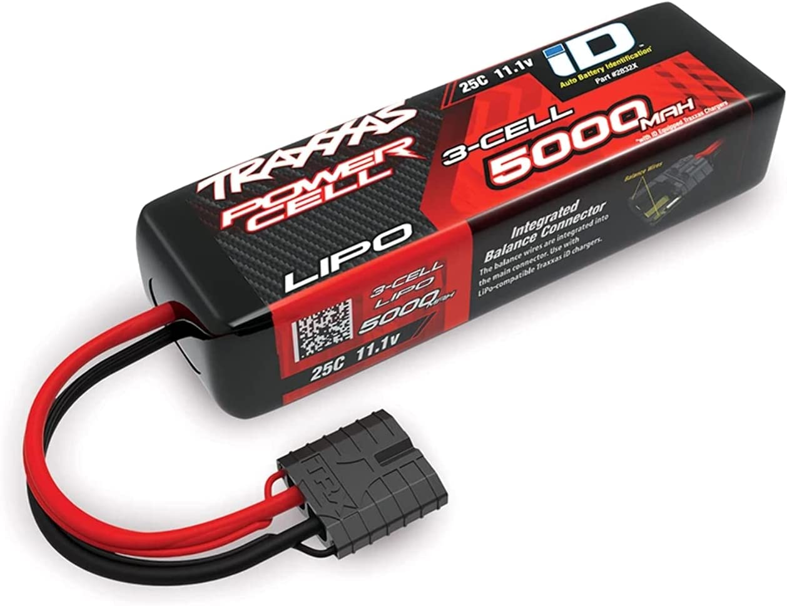
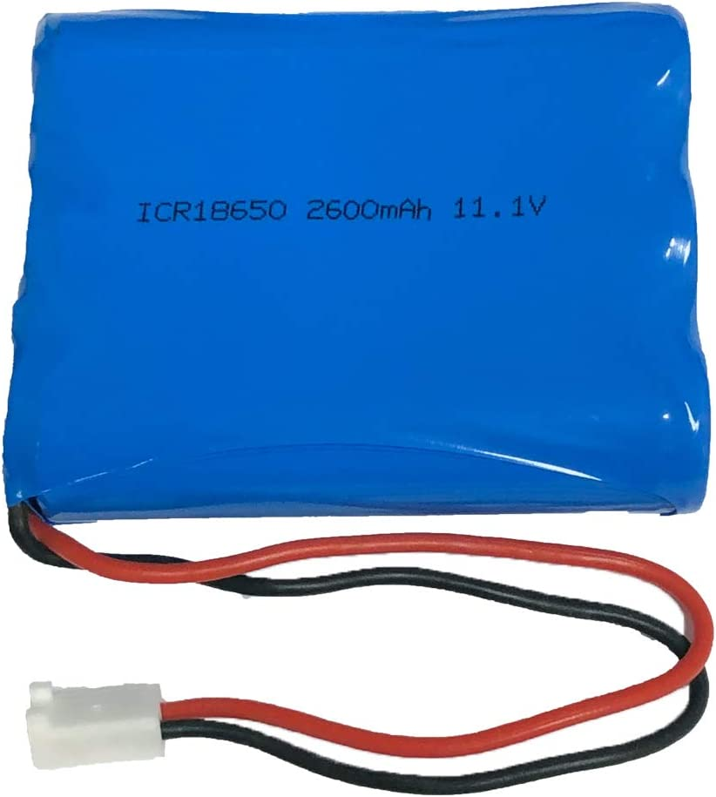
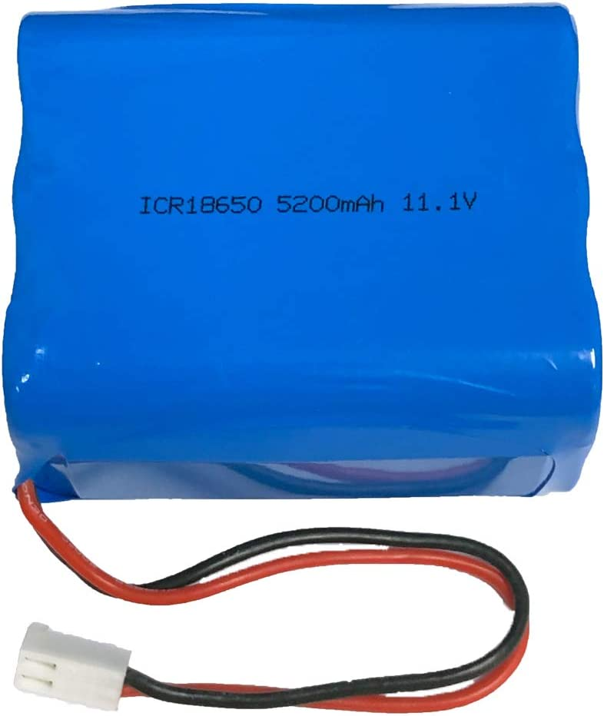
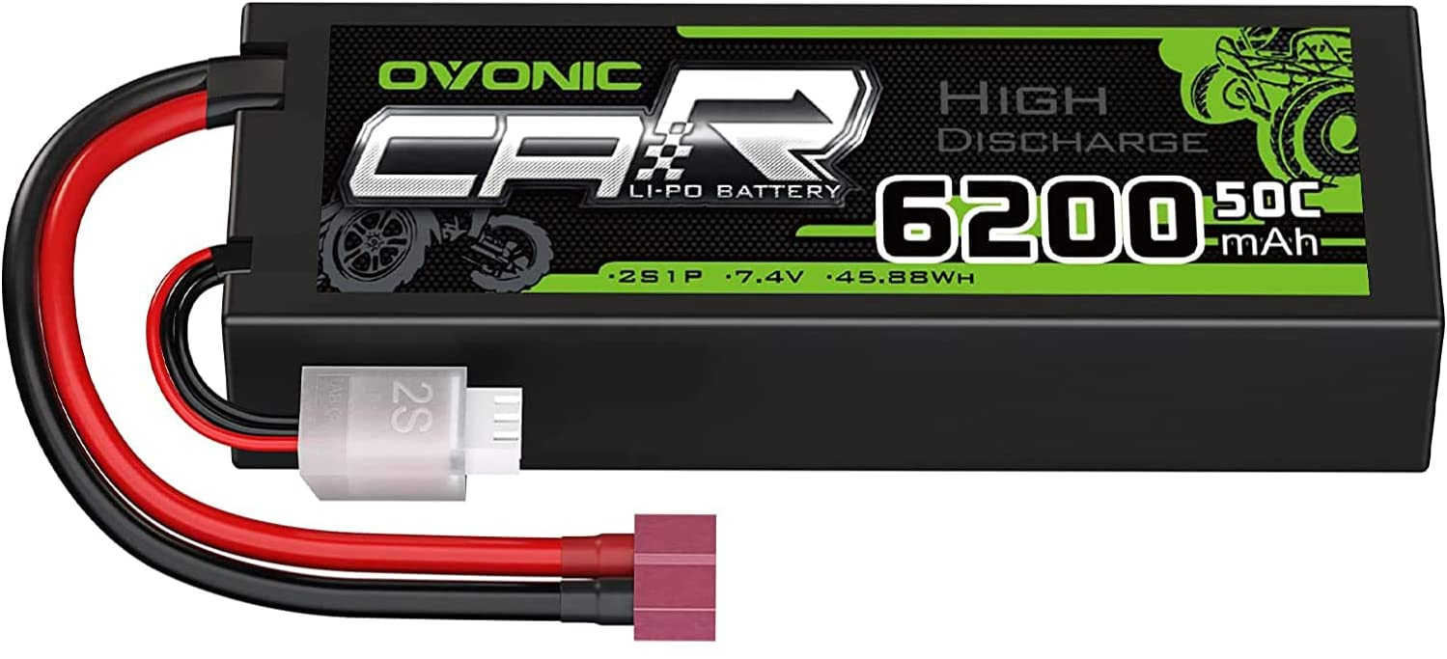
Hardware for Educational Deployment - Battery
Candidates | Voltage Rating | Current Capacity | Discharge | Form Factor | Weight | Cost
OVONIC 3S Li-Po | 11.1 V | 3000 mAh | 50 C | 105x32x28 mm | 193 g | $22.81
Traxxas 3S Li-Po | 11.1 V | 5000 mAh | 25 C | 135x44x28 mm | 354 g | $69.95
OVONIC 2S Li-Po | 7.4 V | 6200 mAh | 50 C | 137x46x24 mm | 280 g | $19.5
AES 3 Cell Li-Ion | 11.1 V | 2600 mAh | 1.6 C | 69x57x18 mm | 156 g | $36.00
AES 6 Cell Li-Ion | 11.1 V | 5200 mAh | 1.6 C | 69x57x39 mm | 283 g | $59.00

Slide 7
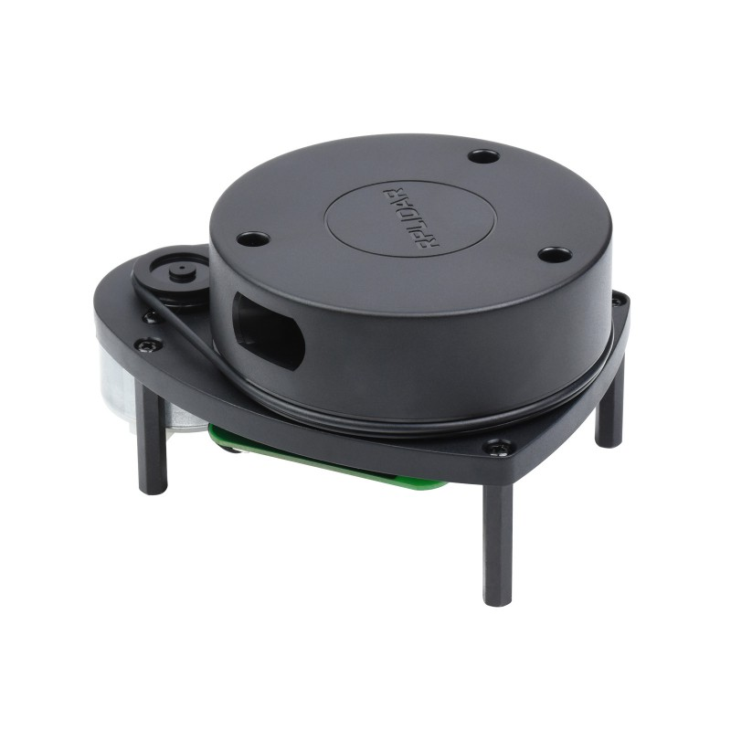
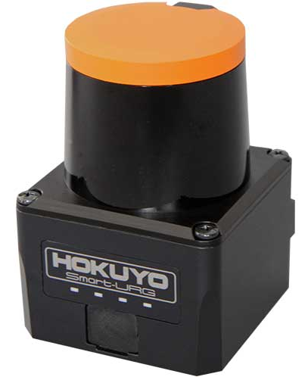
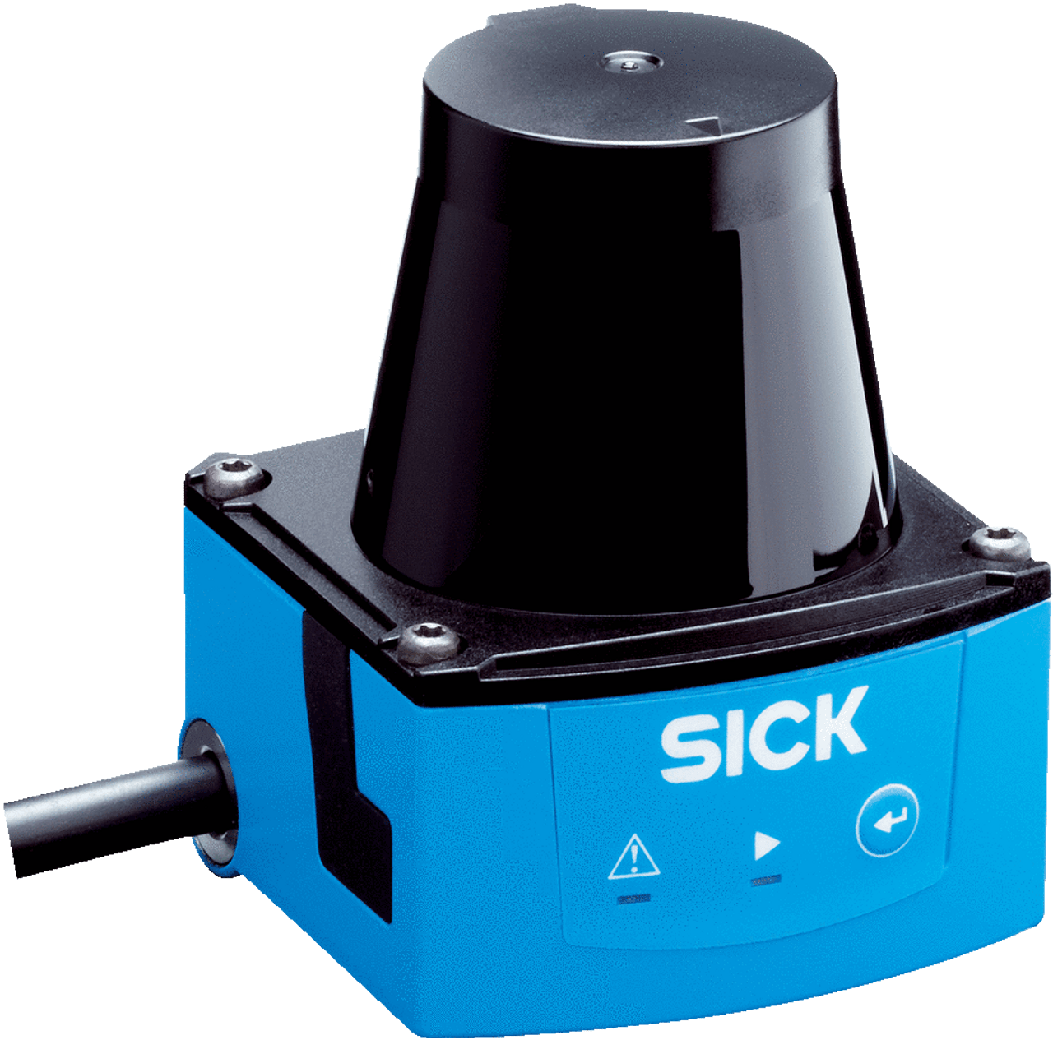
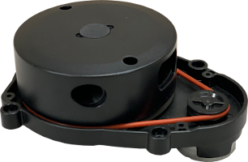
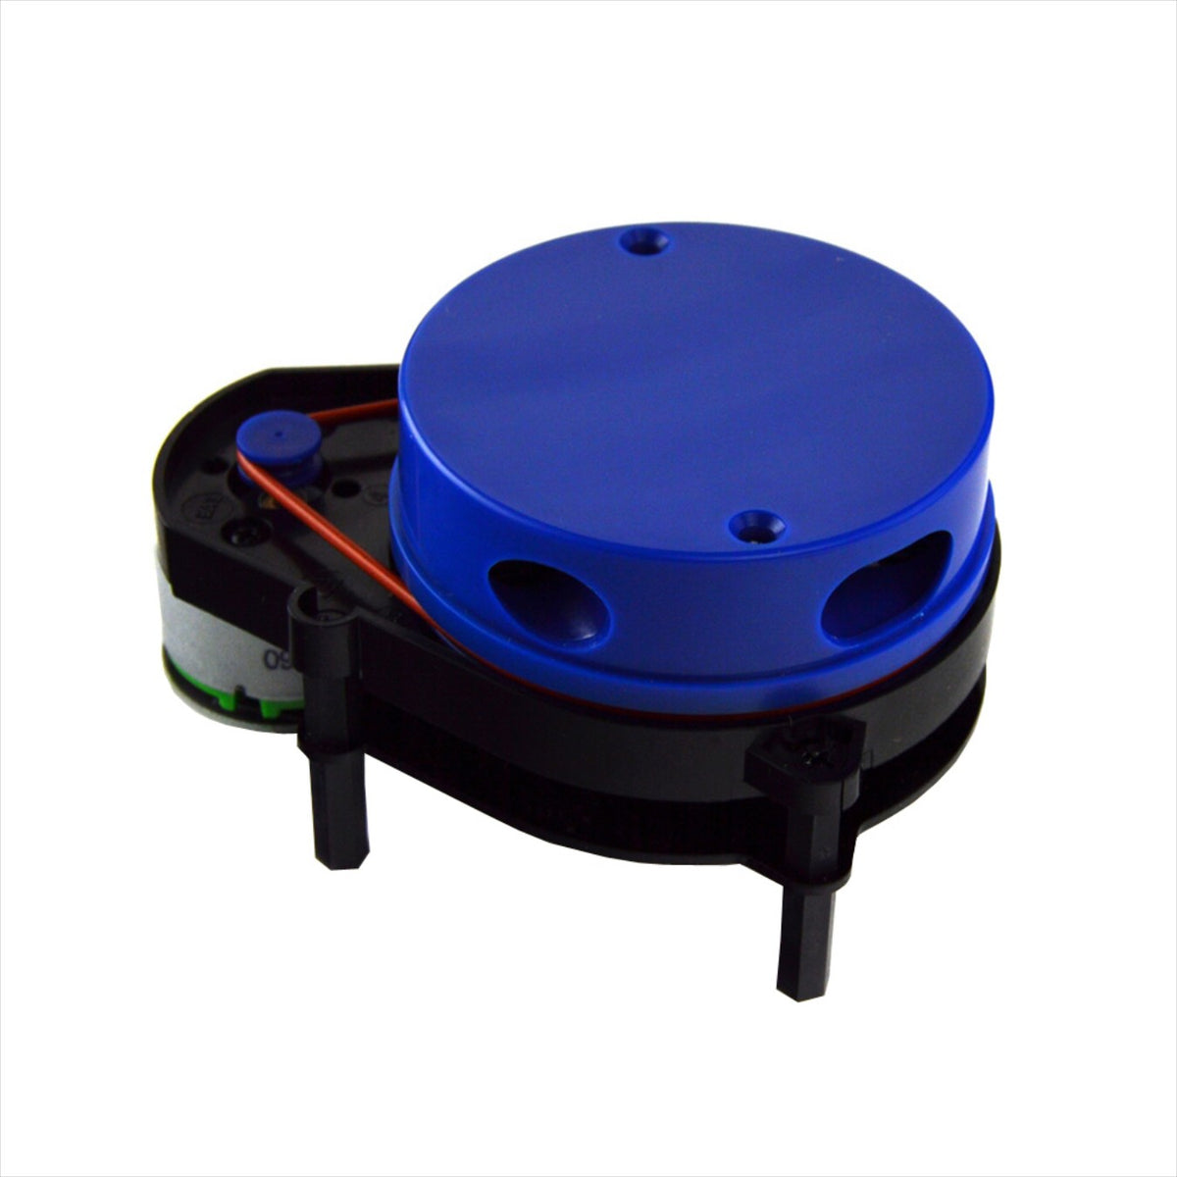
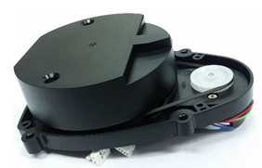
Hardware for Educational Deployment - LIDAR
Candidates | Range | FOV | Resolution | Sampling Rate | Scan Rate | Cost
ROBOTIS LDS-01 | 0.12 – 3.5 m | 360° | 1° | 1.8 kHz | 5.0 Hz | $196.10
ROBOTIS LDS-02 | 0.16 – 8.0 m | 360° | 1° | 2.3 kHz | 5.0 Hz | $211.38*
Slamtec RPLIDAR A1 | 0.15 – 12.0 m | 360° | 1° | 8.0 kHz | 10.0 Hz | $99.00
Slamtec RPLIDAR A3 | 0.20 – 25.0 m | 360° | 0.225° | 16.0 kHz | 15.0 Hz | $599.00
YDLIDAR X4 | 0.12 – 10.0 m | 360° | 0.645° | 5.0 kHz | 10.0 Hz | $79.99
Hokuyo UST-10LX | 0.06 – 30.0 m | 270° | 0.125° | N/A | 40.0 Hz | $1,595.00
Sick TIM310 | 0.05 – 25.0 m | 270° | 0.33° | N/A | 15.0 Hz | $1,503.00
*Exact cost data for LDS-02 is not available, value approximated by adding 25% markup to LDS-01 cost.

Slide 8
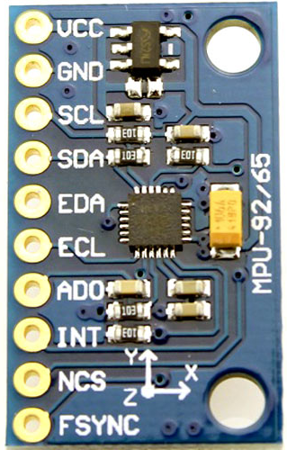
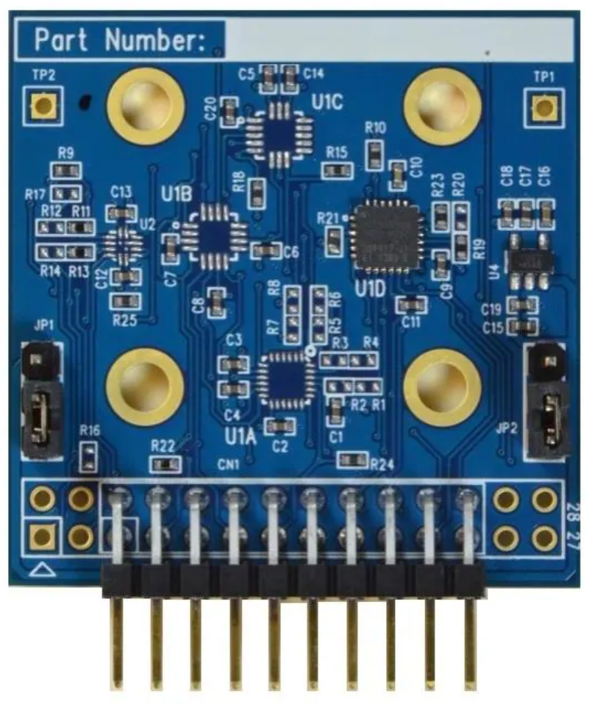
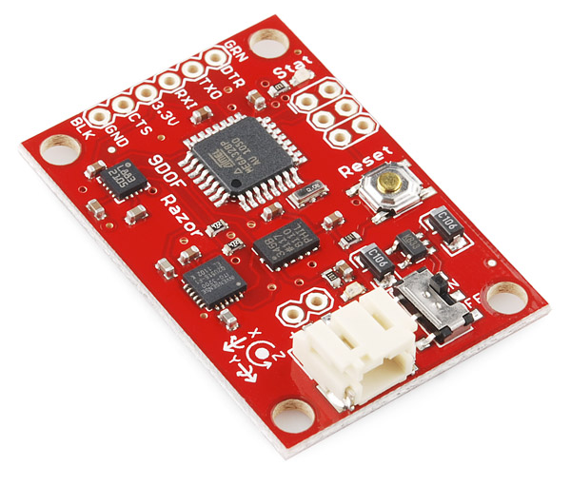
Hardware for Educational Deployment - IMU
Candidates | DOF | Range | Noise Sensitivity | Form Factor | Weight | Cost
InvenSense MPU-9250 | 9 | ±2000°/s | ±16 g | ±4800 μT | 0.01º/s/√Hz | 300 µg/√Hz | 15x25x3 mm | 3.78 g | $14.99
InvenSense ICM-20648 | 6 | ±2000°/s | ±16 g | 0.015º/s/√Hz | 230 µg/√Hz | 38.1x 38.1x1.6 mm | 4.45 g | $40.00
SparkFun Razor IMU | 9 | ±2000°/s | ±16 g | ±8 G | 0.03º/s/√Hz | 300 µg/√Hz | 28x41x6 mm | 5 g | $124.95
VectorNav VN-110 | 9 | ±490°/s | ±15 g | ±2.5 G | 0.001º/s/√Hz | 40 µg/√Hz | 56x56x23 mm | 125 g | N/A

Slide 9
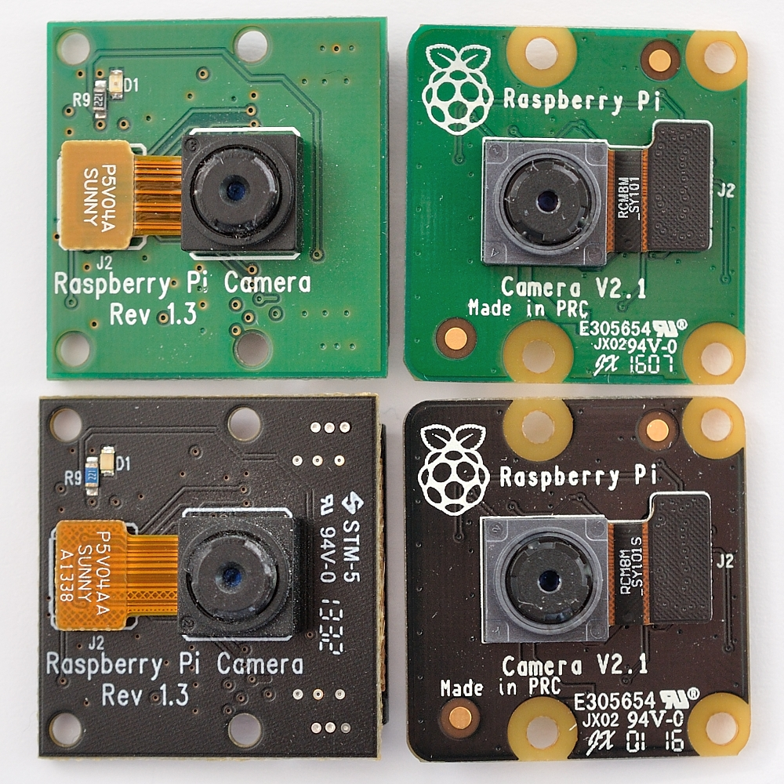
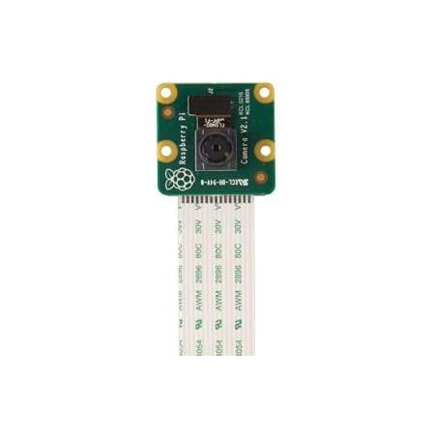
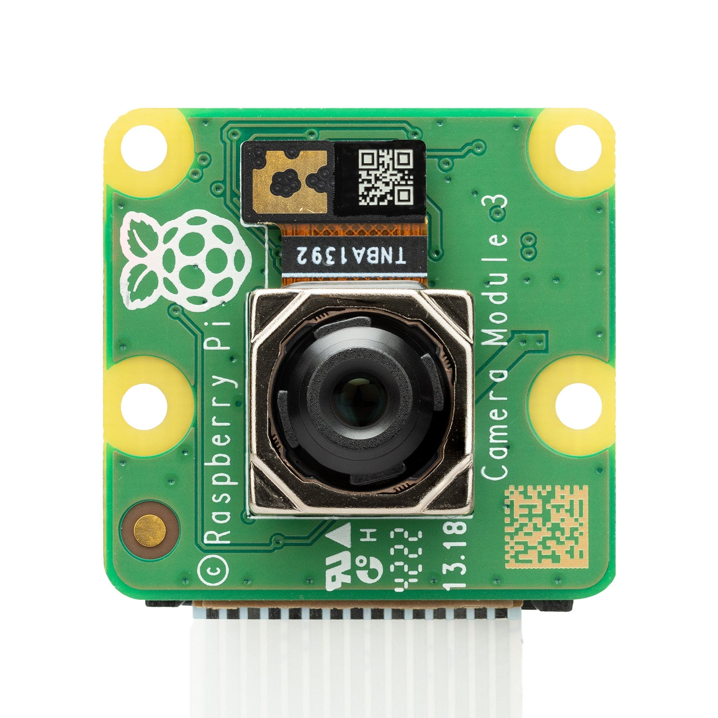
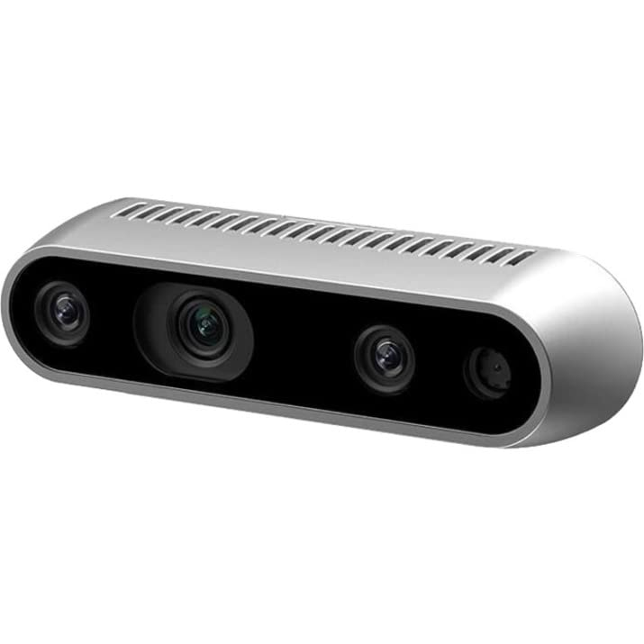
Hardware for Educational Deployment - Camera
Candidates | Depth | Resolution | FOV | Frame Rate | Form Factor | Weight | Cost
PiCamera v1 | No | 5 MP (2592×1944 px) | 53.5º | 1080p30 | 25x24x9 mm | 3 g | $25.00
PiCamera v2 | No | 8 MP (3280 × 2464 px) | 62.2º | 1080p47 | 25x24x9 mm | 3 g | $25.00
PiCamera v3 | No | 11.9 MP (4608 x 2592 px) | 66º | 1296p56 | 25x24x11.5 mm | 4 g | $25.00
Intel RealSense D435 | Yes | 2 MP | 69º |87º | 1080p30 |720p90 | 90x25x25 mm | 72 g | $333.75
ZED X Mini | Yes | 2.3 MP | 110º |120º | 1200p60 |1200p120 | 94x30x37 mm | 150 g | $549.00
Note: Detailed comparison of Pi camera versions is available here

Slide 10
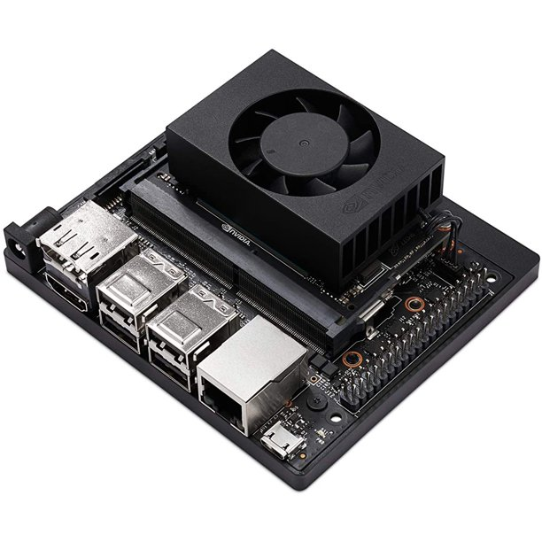
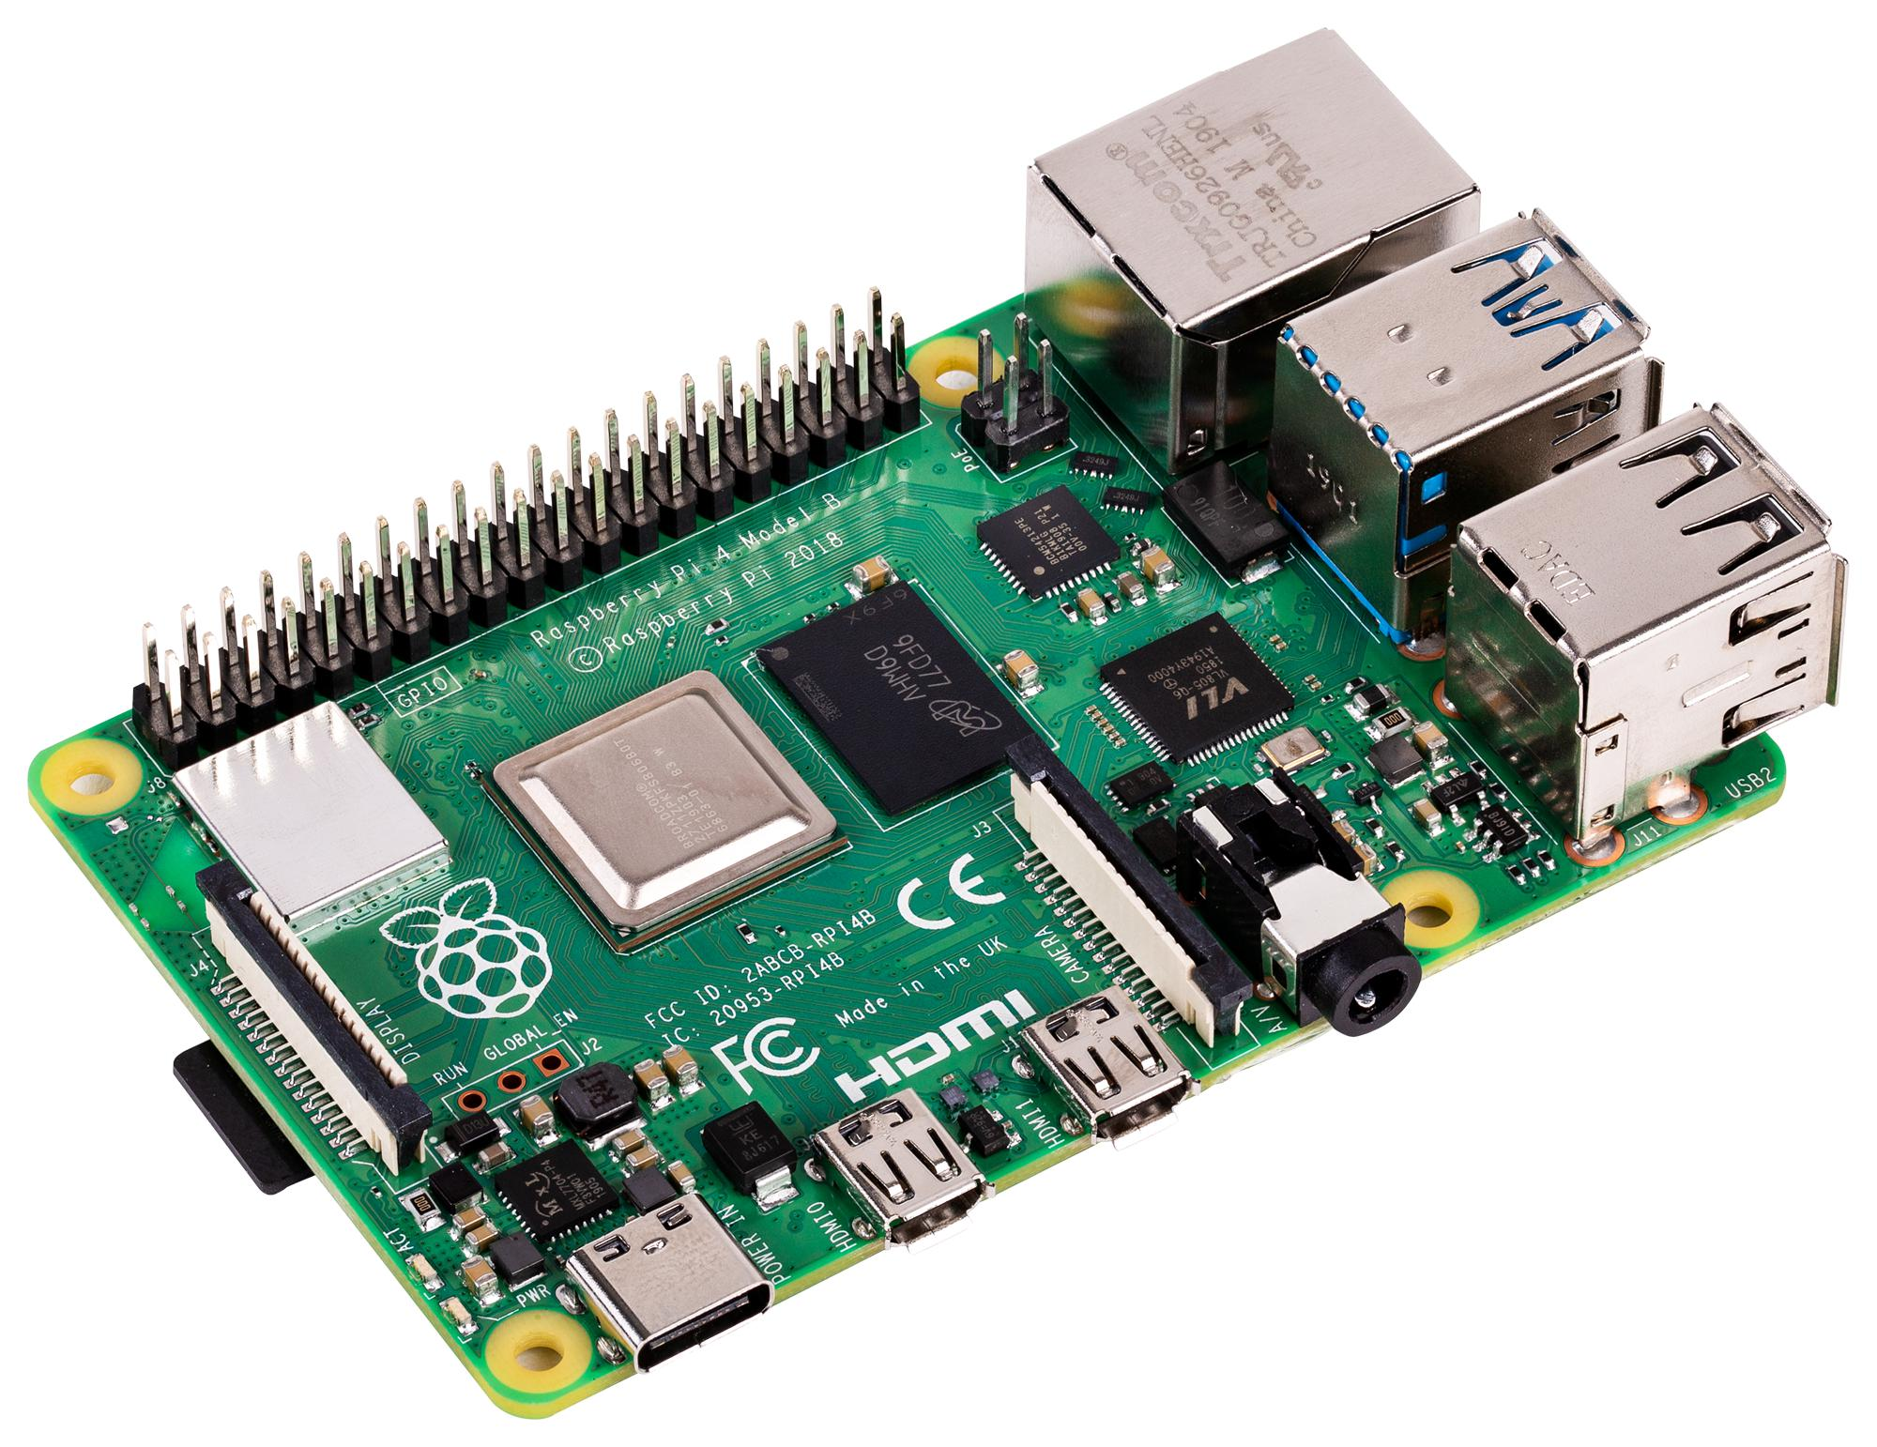
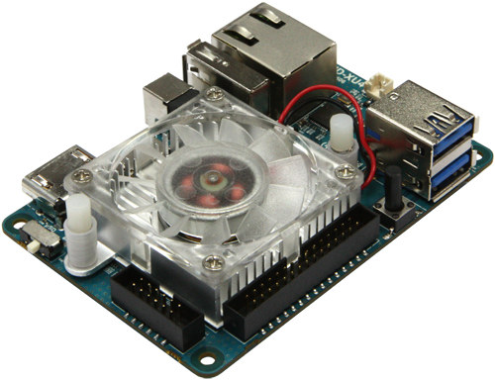
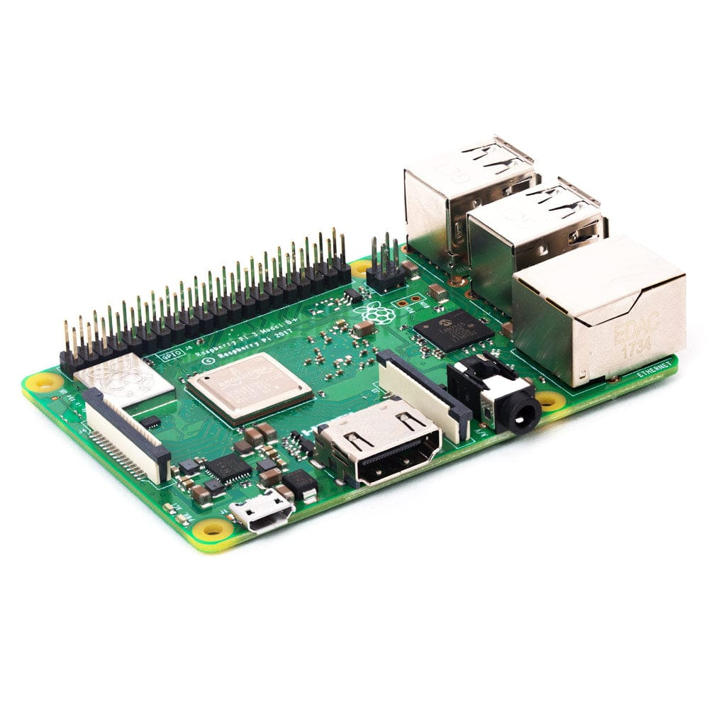
Hardware for Educational Deployment - Computer
Candidates | CPU | GPU | Memory | Form Factor | Weight | Cost
Raspberry Pi 3B+ | Cortex-A53, 1.4 GHz | Videocore-IV | 1GB LPDDR2 | 82x56x19.5 mm | 50 g | $35.00
Raspberry Pi 4B | Cortex-A72, 1.5 GHz | VideoCore VI | 1-8 GB LPDDR4 | 88x58x19.5 mm | 46 g | $75.00
Odroid XU4 | Cortex-A15, 2.0 GHz/ Cortex-A7, 1.3 GHz | Mali-T628 MP6 | 2 GB LPDDR3 | 83x58x20 mm | 38 g | $59.00
NVIDIA Jetson Nano b01 | Cortex-A57, 1.43 GHz | 128-core Maxwell | 4 GB LPDDR4 | 100x80x29 mm | 141 g | $149.00
NVIDIA Jetson Xavier NX | NVIDIA Carmel, 1.9 GHz | 384-core Volta | 8-16 GB LPDDR4x | 103x90.5x31 mm | 172 g | $1999.00

Slide 11
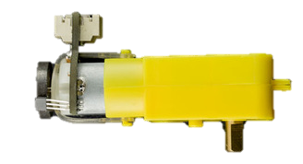
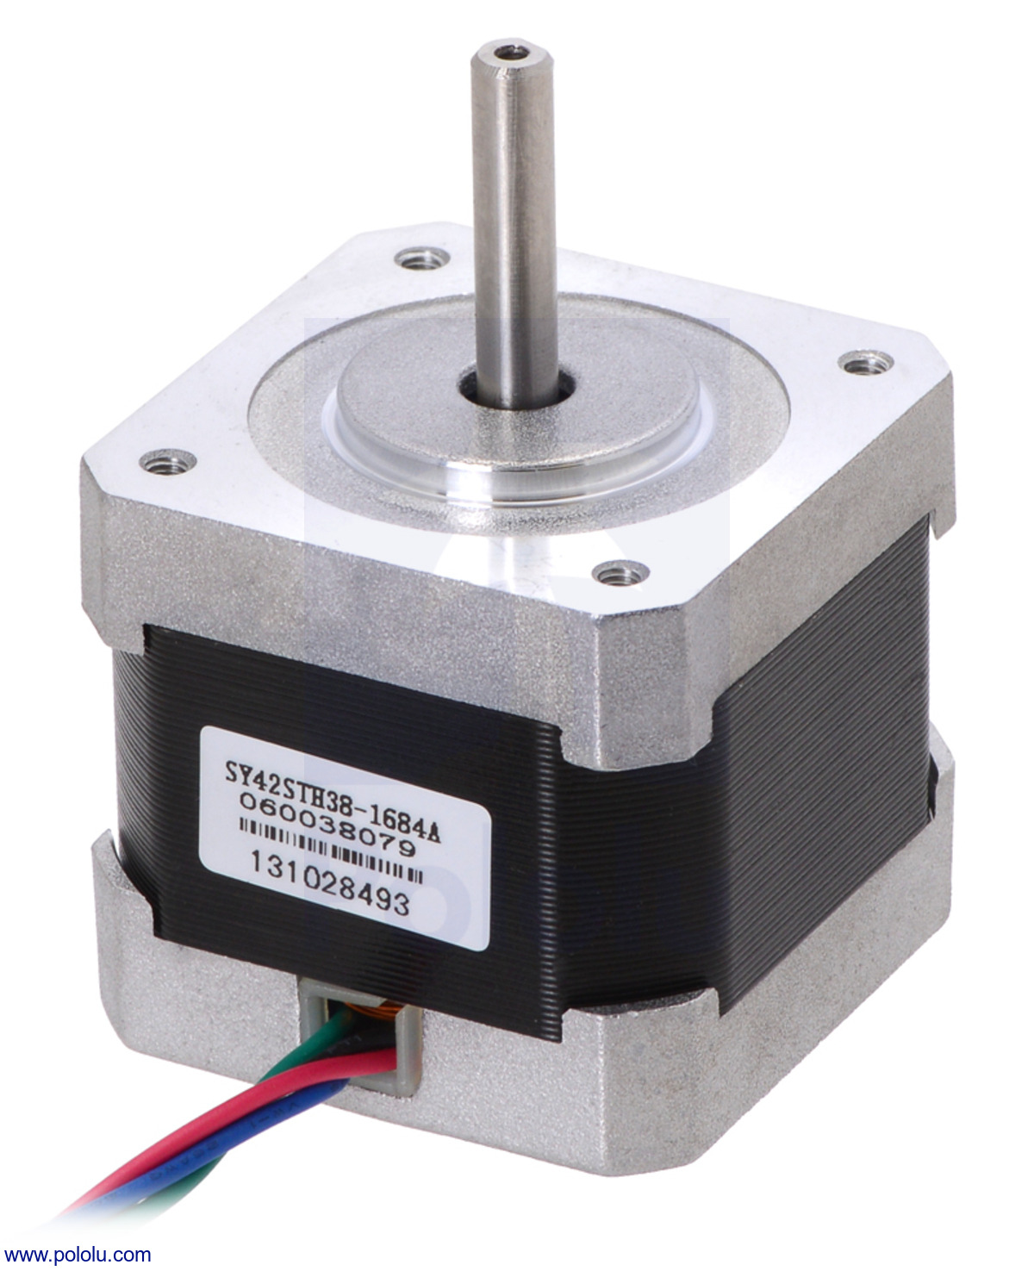
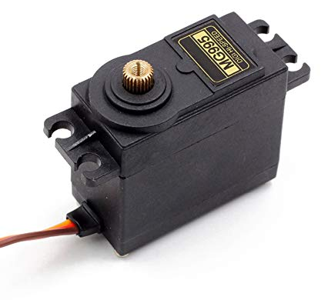
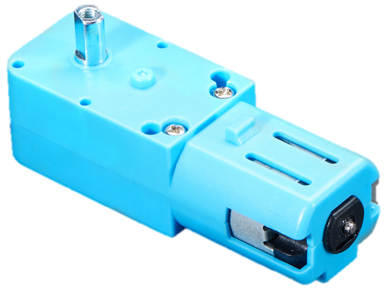
Hardware for Educational Deployment - Actuators
Candidates | Power Rating | Range | Speed | Torque | Encoder | Form Factor | Weight | Cost
DYNAMIXEL XL430-W250* | 11.1 V | 1.3 A | 360° | 57 RPM | 1.4 Nm | 2048 CPR | 28.5x46.5x34 mm | 57.2 g | $49.90
All Metal TT Motor | 6.0 V | 1.0 A | 360° | 120 RPM | 0.18 Nm | N/A | 69.5x22x20.7 mm | 39.4 g | $5.95
TT Motor with Encoder | 6.0 V | 2.8 A | 360° | 160 RPM | 0.08 Nm | 1920 CPR | 79.5x22x20.7 mm | 50.0 g | $7.40
NEMA 17 Stepper Motor | 12.0 V | 350 mA | 360° | 50 RPM | 0.28 Nm | N/A | 58x42.3x42.3 mm | 240 g | $14.00
Tower-Pro MG-995 | 6.0 V | 2.8 A | 170° | 62.5 RPM | 0.98 Nm | Internal feedback | 40.7x19.7x42.9 mm | 62.41 g | $19.95
*ROBOTIS recommends that new and existing AX series users transition to XL430-W250.

Slide 12
Thank You!

